Slide 1



UBA0620– APPLIED MATHEMATICS
A CAPSTONE PROJECT ON
Real-Time Audio Noise Reduction
PRESENTED BY
ASHWATH DRAVID 192512175
ASHVIN MIJ – 192572155
LAKSHMI NARAYANAN NTN - 192524353
UNDER THE GUIDENCE
Dr. SUDAR MOZLI
ASSISTANT PROFESSOR (SG)
DEPARTMENT OF PURE AND APPLIED MATHEMATICES

Slide 2
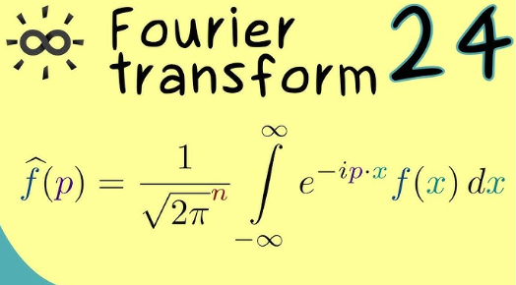
OBJECTIVES
To analyze audio signals using Fourier Transform.
To remove unwanted noise frequencies.
To reconstruct clean audio using Inverse FFT.
To verify signal energy using Parseval’s theorem.

Slide 3
The Problem
Background noise reduces audio quality
Traditional filtering methods are less efficient for complex signals
Solution
Use Fourier Transform to identify noise frequencies.
Apply filtering in frequency domain.
Reconstruct cleaner audio using Inverse Fourier Transform.

Slide 4
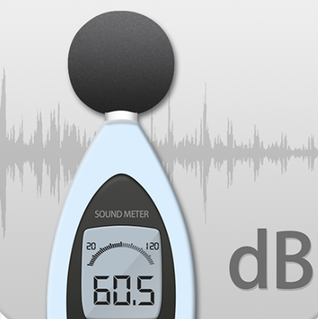
MODULE 1– Audio Input and noise Detection
Capture live audio through a microphone.
Convert the audio signal into digital form.
Identify unwanted noise such as fan noise, background sounds, and environmental noise.
Analyze the audio using FFT (Fast Fourier Transform).

Slide 5
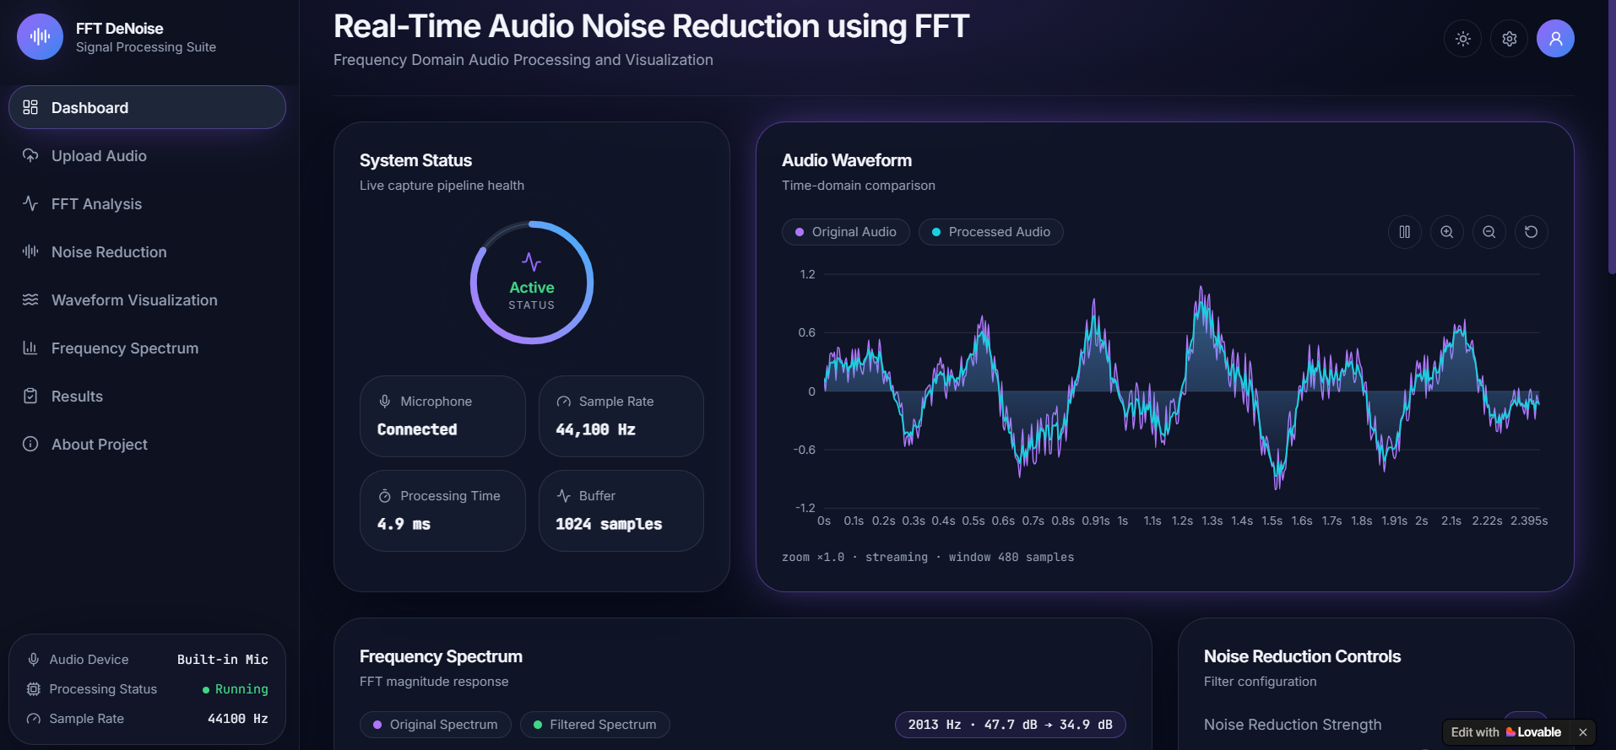

Slide 6
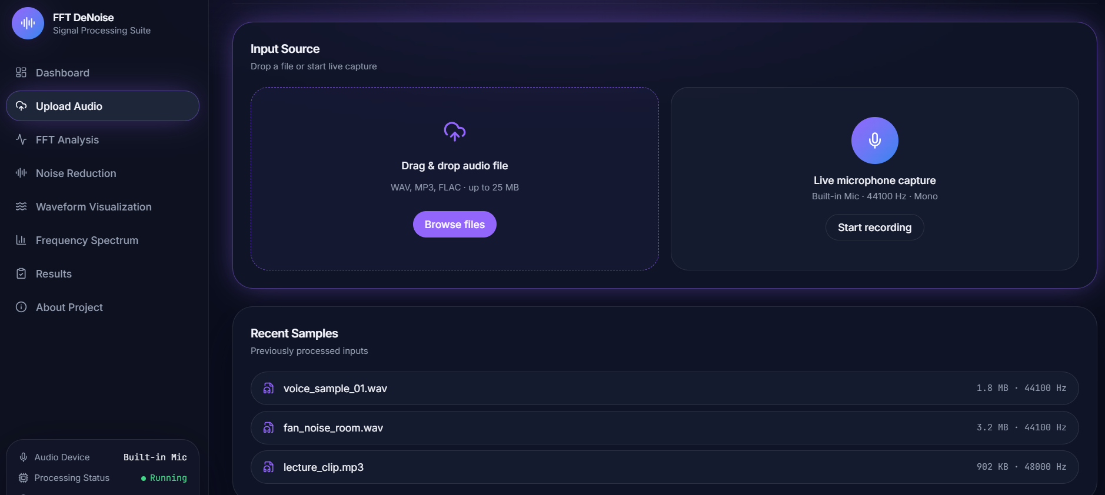
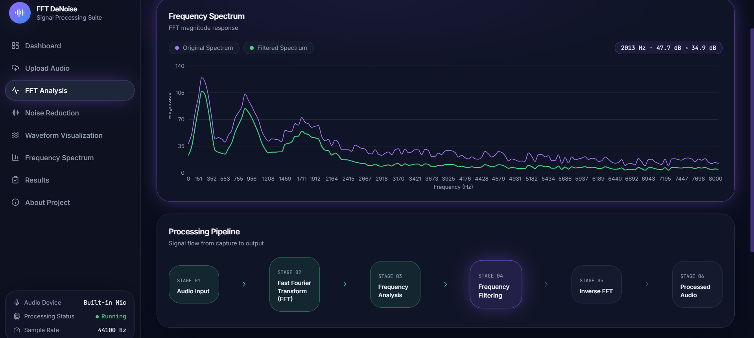

Slide 7
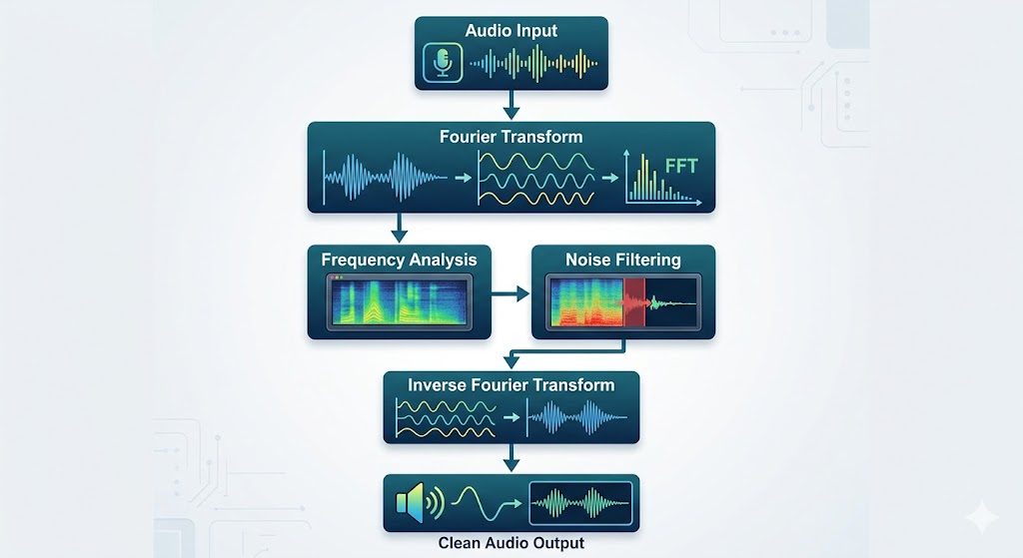
BLOCK DIAGRAM

Slide 8
Module 2--Real-time noise Reduction
Process the incoming audio continuously.
Separate the useful speech/audio signal from unwanted noise.
Apply a suitable digital filter / noise reduction algorithm.
Reduce noise while maintaining the quality of the original audio.

Slide 9

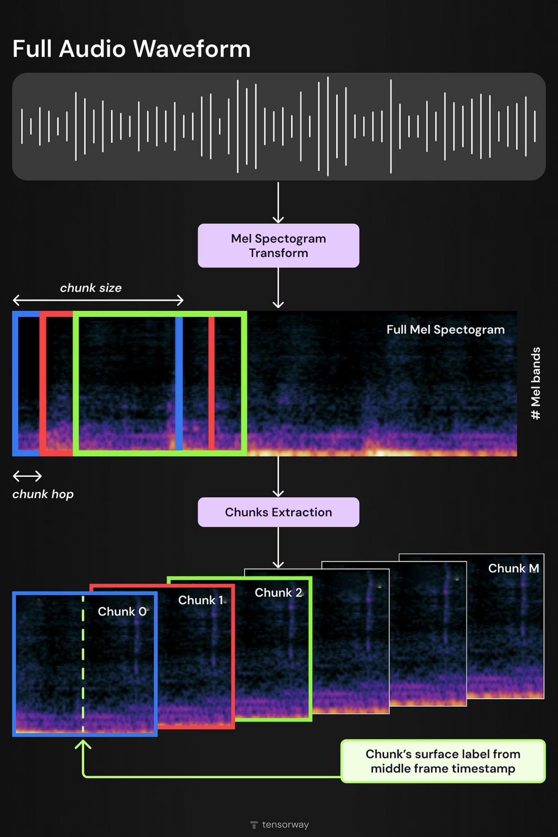

METHODOLOGY
Audio Recording/Input
Apply FFT
Frequency analysis
Noise Filtering
Apply Inverse FFt
Generate Clean Audio
Verify parseval theorem

Slide 10
Module 3– Enhanced Audio Output & Performance
Convert the processed signal back into audible audio.
Provide real-time noise-reduced output through speakers/headphones.
Compare the original and processed audio.
Measure performance using parameters like SNR, noise level, and processing time

Slide 11
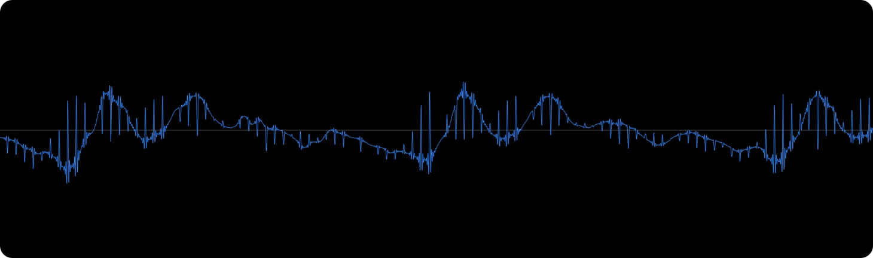
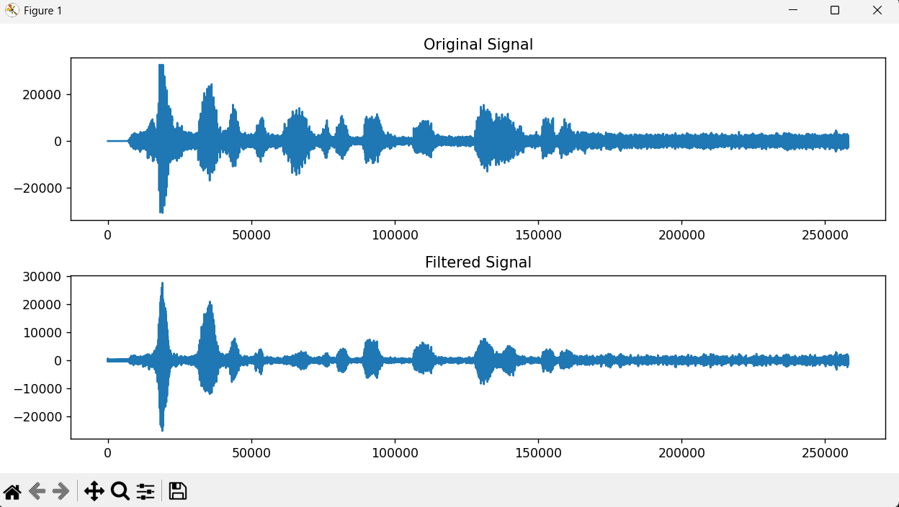
RESULTS
Frequency spectrum obtained successfully
Noise frequencies identified
Audio filtering performed
Cleaned audio reconstructed

Slide 12

The Future of Audio Clarity
Fourier Analysis
Parseval's Guarantee
Frequency-domain decomposition
Energy conservation in processing
Next Frontier
Adaptive algorithms for dynamic environments

Slide 13
Reference
No. | Author(s) | Year | Title
1 | Chengyu Zheng, Yuan Zhou, Xiulian Peng, Yuan Zhang & Yan Lu | 2023 | Real-time Speech Enhancement with Dynamic Attention Span (URC | IEEE Universal Resource Center)
2 | Chaitanya Jannu & Sunny Dayal Vanambathina | 2023 | DCT Based Densely Connected Convolutional GRU for Real-Time Speech Enhancement (Sage Journals)
3 | Sefik Emre Eskimez, Takuya Yoshioka, Alex Ju, Min Tang, Tanel Pärnamaa & Huaming Wang | 2023 | Real-Time Joint Personalized Speech Enhancement and Acoustic Echo Cancellation (ISCA Archive)
4 | Candy Olivia Mawalim, Shogo Okada & Masashi Unoki | 2024 | Are Recent Deep Learning-Based Speech Enhancement Methods Ready to Confront Real-World Noisy Environments? (ISCA Archive)
5 | Hoang Ngoc Chau, Nguyen Thi Nhat Linh, Tuan Kiet Doan & Quoc Cuong Nguyen | 2024 | Multi-stage Temporal Representation Learning via Global and Local Perspectives for Real-Time Speech Enhancement (sciencedirect.com)

Slide 14
THANK YOU

